Slide 1
Vet Management App
Peter Mordaunt

Slide 2
Brief
A veterinary practice has approached you to build a web application to help them manage their animals and vets.
Vets look after MANY animals
Animals have a SINGLE vet
Owners can have MANY animals
Animals have a SINGLE owner
Animals & Vets can have MANY appointments

Slide 3
Brief - Functionality
Be able to assign or register Pets with Vets
CREATE – Pets, Vets, Owners & Appointments
READ – Vet, Pet & Owner records, Appointment details and notes.
UPDATE – Owners & Pet records, Vet Details, Appointment Notes
DELETE – Pets or Vets that leave the practice.

Slide 4

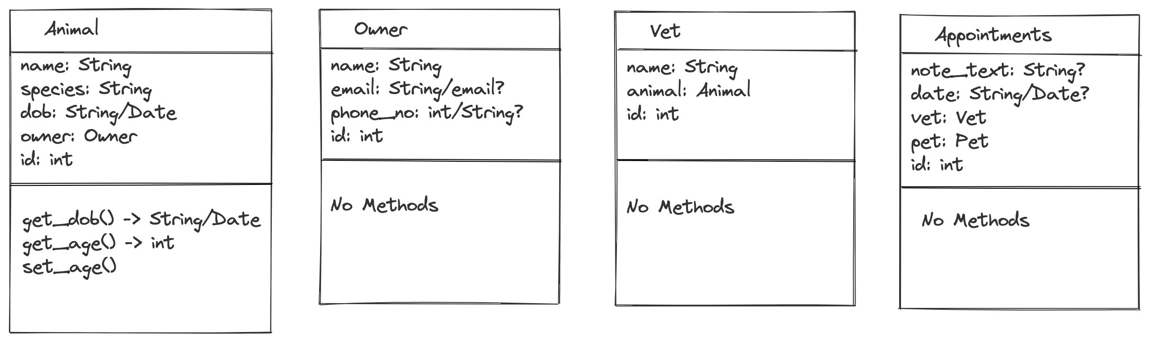
Planning – Class Diagrams

Slide 5
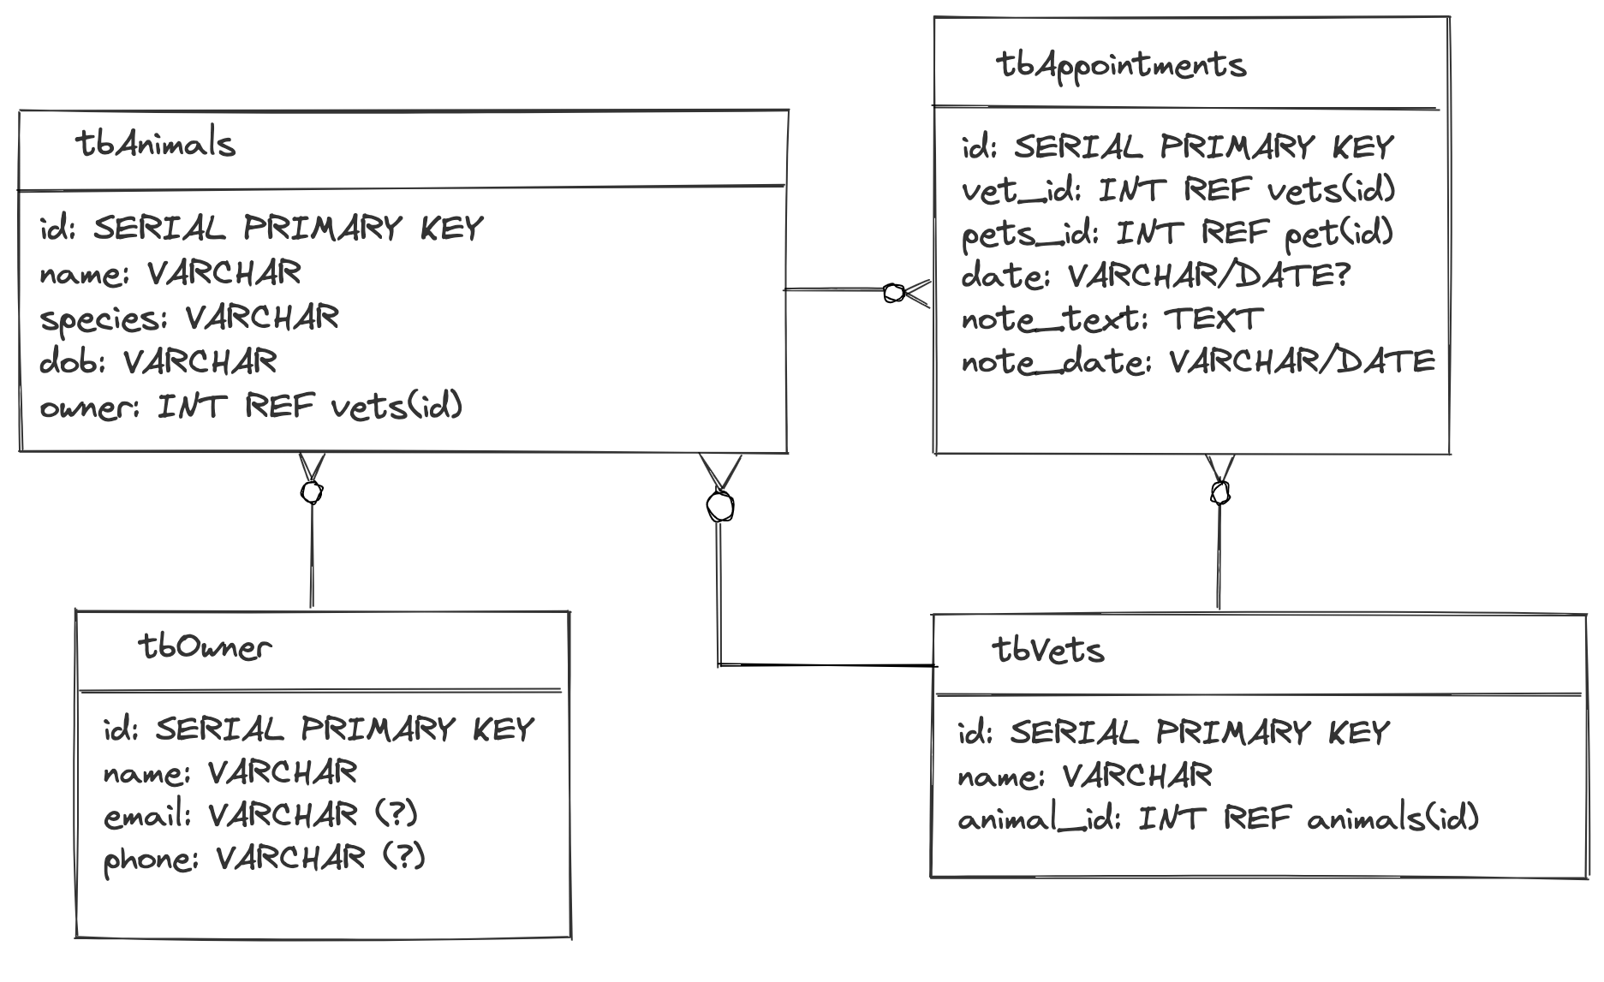
DB
Table
Diagrams

Slide 6
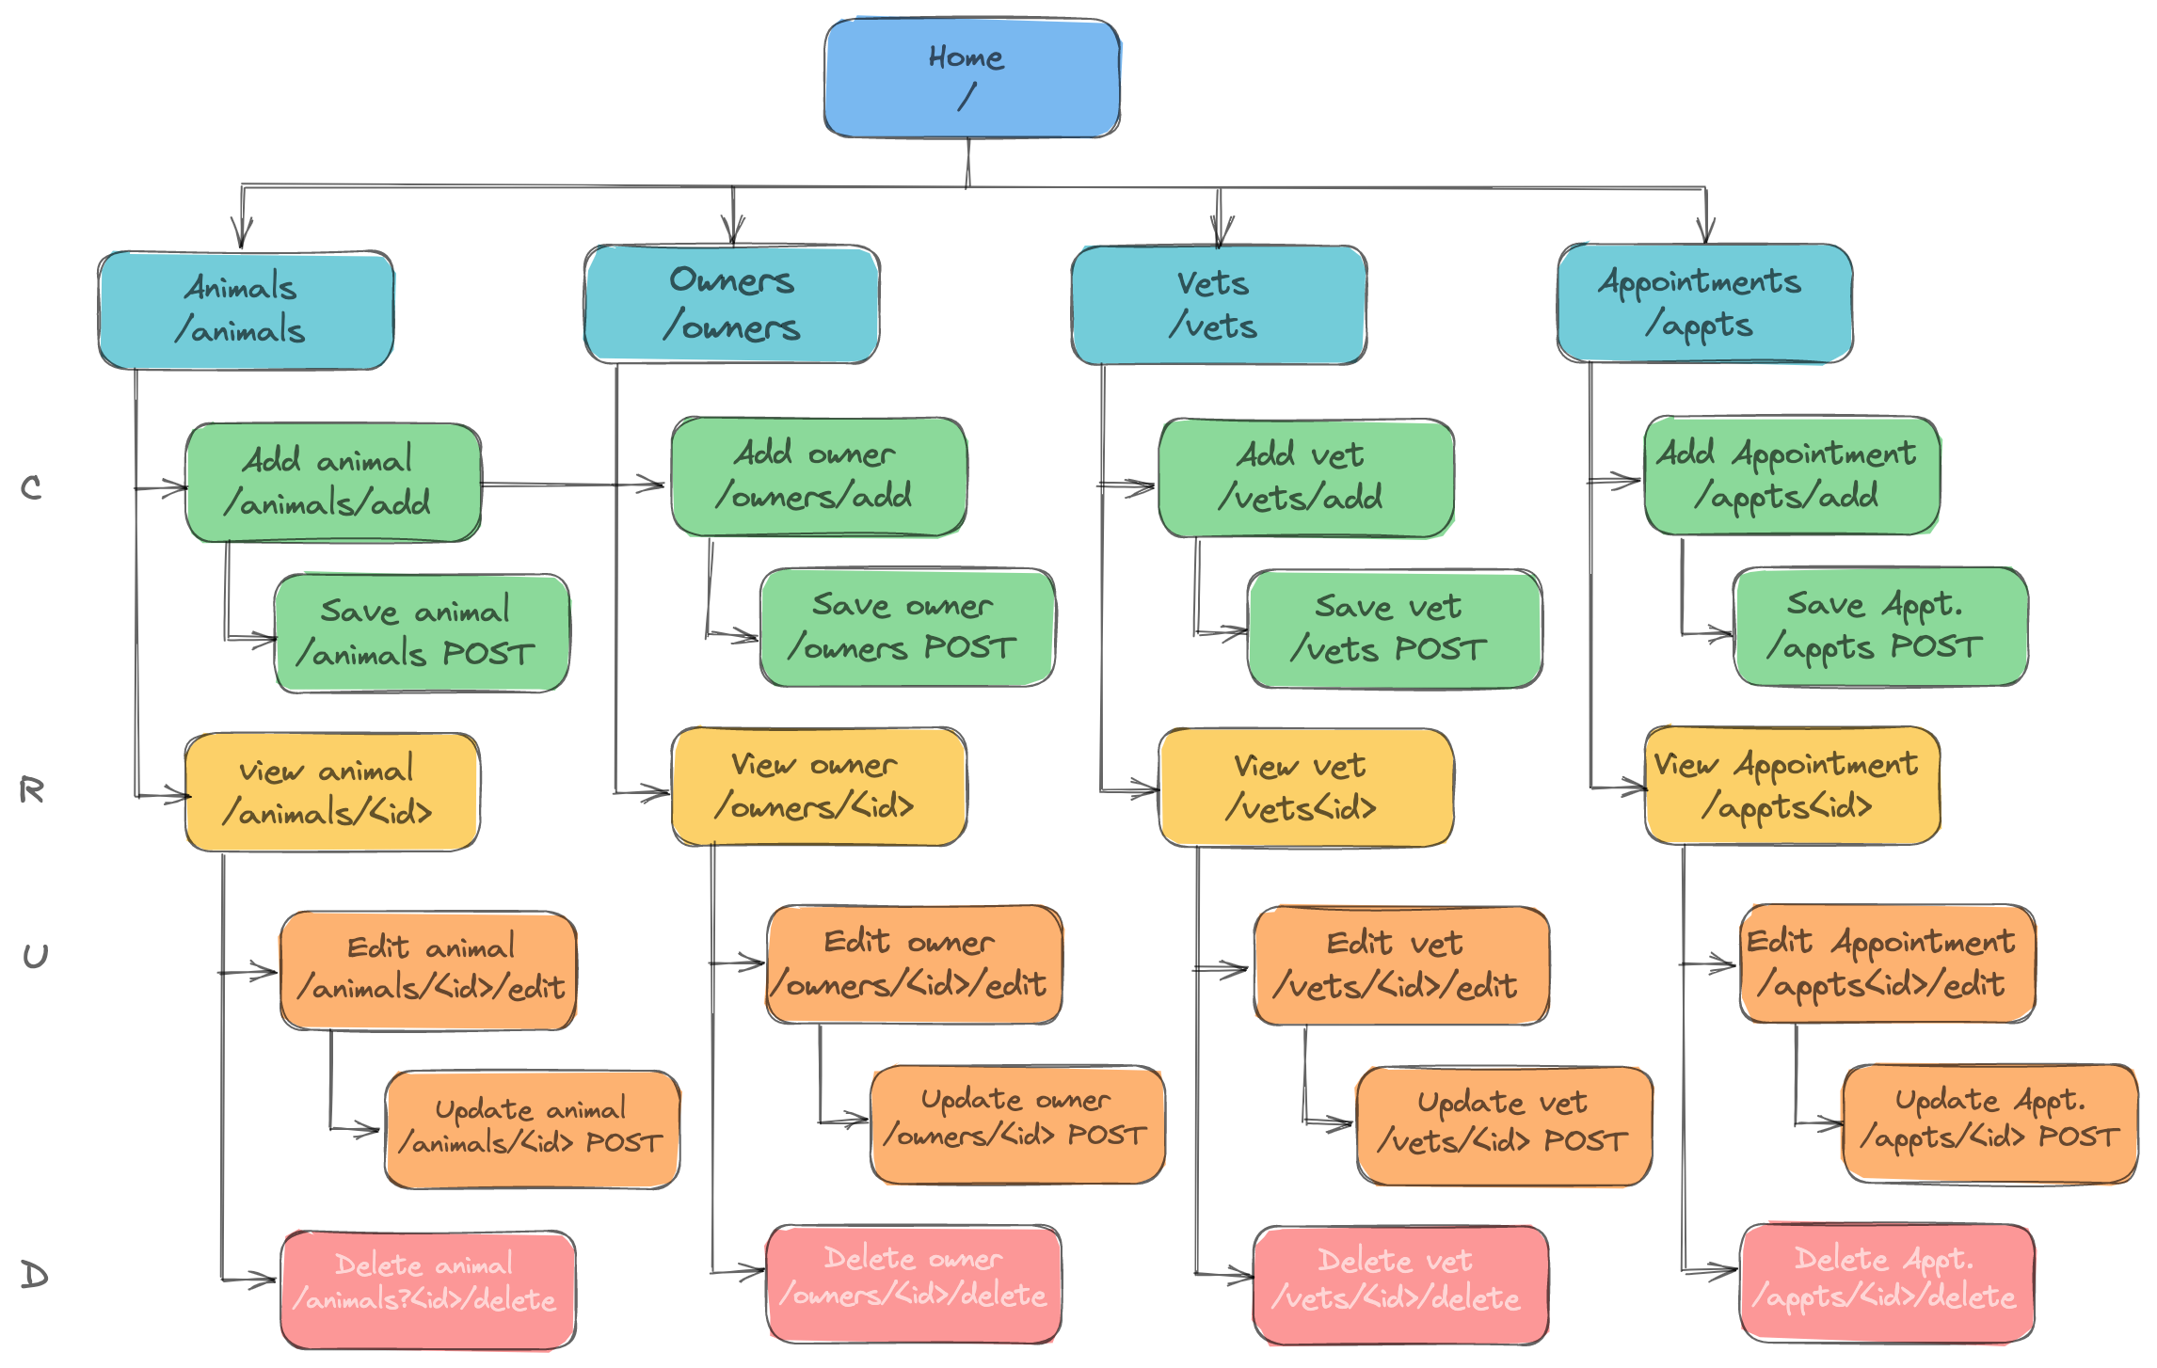
Site
Map

Slide 7
Extension Ideas
Add warning message for deleting
Add confirm message for updates
animal.get_all_appointments() (for vet too, maybe even owners for all animals)
Add all appointments in aside on view animal page

